Slide 1
student enrollment database project

Slide 2
TEAM Members
Mariam Medhat Mahmoud Fahmy
BN
48
Zeinab Ahmed Younis Ahmed
BN
22
Youmna Waleed Tawfeeq Hassan
BN
54
Sayed Ibrahim Sayed Ibrahim
BN
24
Alaa Ahmed Ibrahim Idrees
BN
11

Slide 3
GitHub repository link
https://github.com/College-Projects/StudentEnrollmentDatabase
Online server link
http://studentenroll.infinityfreeapp.com/

Slide 4
Content
Project’s Idea
Database Structure
Tables’ Structure
Xampp Server
Server Hosting
Conclusion

Slide 5
Project’s Idea
It’s a user-friendly website that allows the user to add, display, update, and delete students’ data from the database. Our website is executed using HTML, PHP, CSS, and SQL languages.

Slide 6
Database structure
Our database consists of 2 tables:
User Table
for an admin who controls the students’ data (ex: affairs officer).
Registration table
that contains all students’ data.

Slide 7
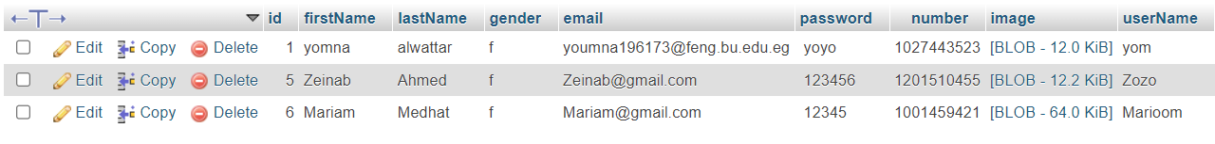
Tables’ structure
User Table

Slide 8
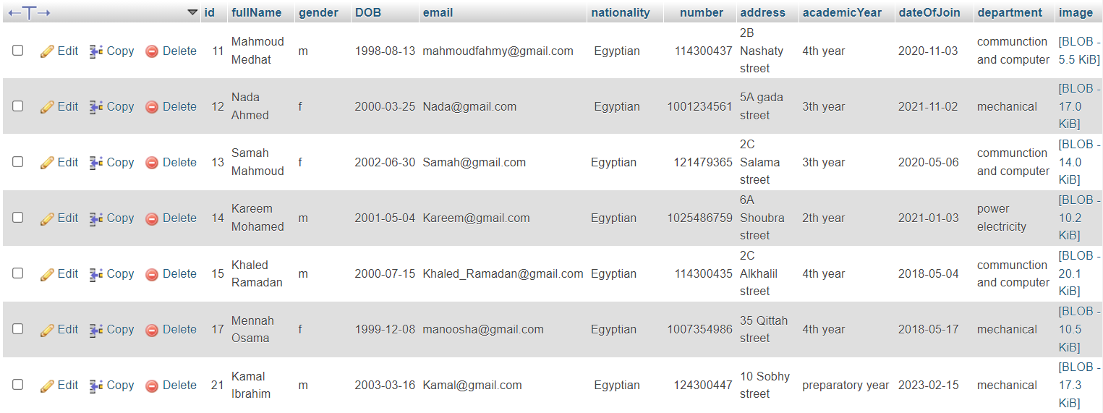
Tables’ structure
Registration Table

Slide 9

Xampp Server
XAMPP is a free and open-source cross-platform web-server solution stack package developed by Apache Friends, consisting mainly of the Apache HTTP server, MariaDB database, and interpreters for scripts written in the PHP and Perl programming languages. Since most actual web server deployments use the same components as XAMPP, it makes transitioning from a local test server to a live server possible.
Letter | Meaning
X | An ideographic letter referring to cross-platform
A | Apache, or its expanded form, Apache HTTP Server
M | MariaDB (formerly MySQL)
P | PHP
P | Perl

Slide 10
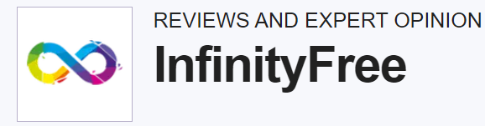
Server Hosting
It’s a completely free website hosting supporting PHP and SQL with no ads.
InfinityFree offers free hosting with the following features:
99.9% uptime
Free subdomain
Free SSL
Unlimited storage

Slide 11
Conclusion
So, the scenario expected in our website is an existing user (ex, affairs officer) signs into the website which allows him to Add, Modify, Display, and Delete students’ data. In addition to that, the admin can display his own profile and edit his own data smoothly and in an easy manner.

Slide 12
THANK YOU

